Slide 1
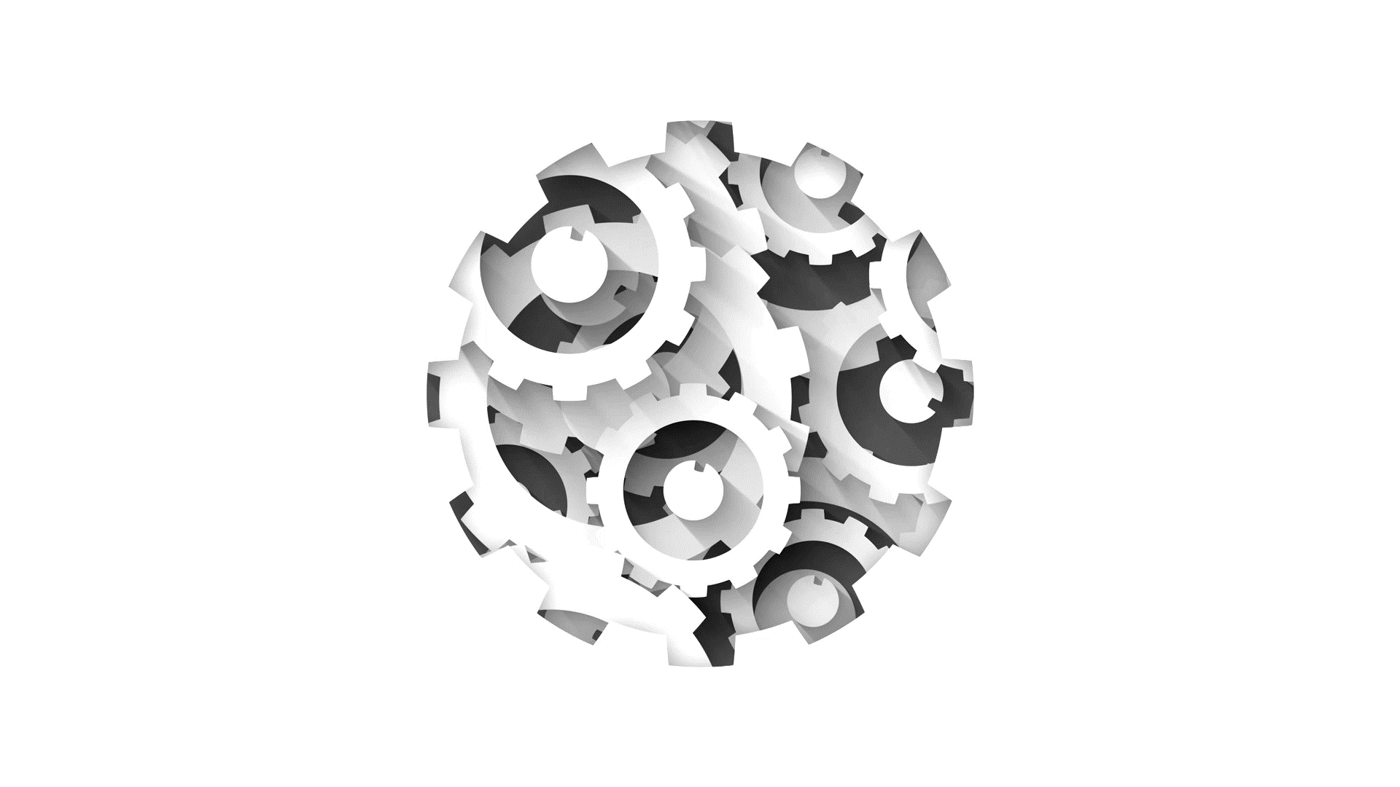
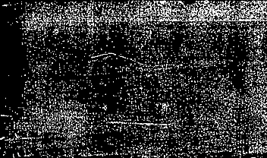

Software Engineering CS411, FALL 2025
Lectures 9: Design Principles III by Dr. Mohamad Kassab
Leonidas Kontothanassis kthanasi@bu.edu

Slide 2

Lesson plan
GRASP Patterns:
Expert
Creator
Controller
Low Coupling/High Cohesion
Polymorphism
Pure Fabrication
Indirection
Don’t Talk to Strangers (Law of Demeter)
UI/UX Design
Interaction Diagrams
we will focus on the remaining patterns in this lecture

Slide 3

PURE FABRICAION

Slide 4
Pure Fabrication…
Intent:
Assign a highly cohesive set of responsibilities to an artificial class that does not represent anything in the problem domain – something made up, in order to support high cohesion, low coupling, and reuse.
Only do when desperate.
(we are often desperate!)

Slide 5
…Pure Fabrication
Problem:
OO is characterized by implementing as software classes representations of real-world concepts.
What if assigning responsibilities to domain classes results in poor cohesion or tight coupling?
Notes:
What object should have the responsibility, when you do not want to violate high cohesion and low coupling or other goals but solutions offered by other patterns are not appropriate?

Slide 6
Pure Fabrication – Example…
Sale instances are to be stored in a database. By Expert, Sale should have responsibility.
But:
Task requires large number of supporting database ops; none related to the concept of a Sale (incohesive)
Sale class has to be coupled to database interface, so coupling increases - and not even to another domain object!
Saving objects in database is general task for which many classes need support. Placing responsibility in Sale implies poor reuse or lots of duplication in other classes.
Solution: create a class solely responsible for saving objects in some persistent storage

Slide 7
Pure Fabrication – Example…
class Sale: def __init__(self, item_name: str, price: float): self._item_name = item_name self._price = price def get_item_name(self) -> str: return self._item_name def get_price(self) -> float: return self._price
# "Pure Fabrication" class responsible for storing Sale objects class SaleStorage: @staticmethod def save_sale(sale: Sale): # For demonstration, we'll just print out the sale details. # In a real application, this might connect to a database or write to a file. print(f"Saving sale for item: {sale.get_item_name()} with price: ${sale.get_price():.2f}") if __name__ == "__main__": # Create a Sale object my_sale = Sale("Laptop", 999.99) # Use the fabricated SaleStorage class to save the Sale SaleStorage.save_sale(my_sale)

Slide 8

Inheritance Digression
Python has 3 types of methods in classes
@staticmethod: No self parameter, can not modify any class attributes
Like a global function but inside class namespace
@classmethod: No self parameter, but a cls (class) parameter. Can modify class attributes
Class attributes are common across all instances.
In subclasses the cls argument reflects the subclass
Regular functions that accept self as a parameter.
These are the common ones
Regular functions that don’t accept self as a parameter
Don’t do this, it’s a recipe for obscure and difficult to debug errors

Slide 9
Inheritance Digression
Java has 3 types of methods in classes
static: No self parameter, but can modify any static class attributes
Subclassing hides the method, does not override it
Regular functions that accept self as a parameter.
These are the common ones. Self `this` parameter implied. Not possible to omit.
They can modify class attributes
Subclassing overrides the method, does not hide it
Override: Method called depends on actual object type (a child assigned to a parent variable will call the child method)
Hide: Method called depends on variable type (a child assigned to a parent variable will call the parent method).

Slide 10
Pure Fabrication
Consequences:
Low coupling
High cohesion

Slide 11

INDIRECTION

Slide 12
Indirection
Intent:
Assign the responsibility to an intermediate object to mediate between other components or services so that they are not directly coupled.
Problem:
How to de-couple object so that low coupling is supported and reuse potential remains high.
Notes:
Coupling – dependencies

Slide 13
Indirection - Example
In POST app, terminal must use modem to transmit credit payment requests.
OS provide low-level API to modem device.
Class CreditAuthorizationService is responsible for talking to modem.
BUT, for interoperability, do not want device specific details in domain class – highly coupled to OS.
Instead, add intermediate Modem class that presents consistent interface to domain class. Also known as device proxy.
Notes:
Initially Low-level API – dial, receive, send
Creditauthorization service responsible for talking to modem – not good
Instead – add a modem class that presents the interface to the domain class

Slide 14
Indirection : Example
authorize(payment)
CreditAuthorizationService
1:dial(phoneNum)
Modem
Notes:
Assume that :
A point-of-sale terminal application needs to manipulate a modem in order to transmit credit payment request
The operating system provides a low-level function call API for doing so.
A class called CreditAuthorizationService is responsible for talking to the modem
If CreditAuthorizationService invokes the low –level API function calls directly, it is highly coupled to the API of the particular operating system. If the class needs to be ported to another operating system, then it will requiure modification.
Add an intermediate Modem class between the CreditAuthorizationService and the modem API. It is responsible for translating abstract modem requests to the API and creating an Indirection between the CreditAuthorizationService and the modem.

Slide 15

DON’T TALK TO STRANGERS

Slide 16
Don’t talk to Strangers…
Intent:
Assign responsibility to a client’s direct object to collaborate with an indirect object, so that client does not need to know about the indirect object.
Places constraints on what objects should send messages to within a method. Within a method, messages should only be sent to:
self (or this) or an attribute of self or an element of a collection which is an attribute of self
A parameter of the method
An object created within the method
Notes:
Avoid creating design that traverse long object structure paths and send messages to distant, indirect objects

Slide 17
…Don’t talk to Strangers
Problem:
If an object has knowledge of the internal structure of other objects, then it suffers from high coupling.
If a client object has to use a service or obtain info from an indirect object, how can it do so without being coupled to knowledge of the internal structure of its direct server or indirect objects?
Notes:
Problem:
To avoid knowing about the structure of indirect objects?
Solution:
If two classes have no other reason to be directly aware of each other or otherwise coupled, then the two classes should not directly interact

Slide 18
Don’t talk to Strangers – Example…
In POST app, POST instance has attribute referring to Sale, which has an attribute referring to Payment.
POST instances support paymentAmount op, which returns the current amount tendered for the payment.
Sale instances support payment op, which returns the Payment instance associated with the Sale.
Notes:
In a point-of-sale application, assume that a Post instance has an attribute referring to a sale, which has an attribute referring to a payment.
Also,
Post instances support the paymentAmount operation, which returns the current amount tendered for the payment.
Sale instances support the payment operation, which returns the Payment instance associated with the sale.

Slide 19
Don’t talk to Strangers – Example…
One approach is
Notes:
The solution is a violation of this law because the POST instances is sending a message to an indirect object --- the Payment is not one of the five candidates ‘familiars’.

Slide 20
Don’t talk to Strangers – Example…
A better approach is to add responsibility to direct object (Sale) to return payment amount to POST
Known as promoting the interface
Notes:
The solution as the pattern suggests, is to add the responsibilityto the direct object – the sale in this case – to return the payment amount to the POST. This is known as promoting the interface, which is the general solution to support this principle. Therefore , a paymentAmount operation is added to sale so that the POST does not have to talk to a stranger.

Slide 21
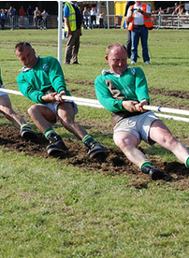
Tensions
This Photo by Unknown Author is licensed under CC BY-SA

Slide 22
Graps Pattern Tension Examples
Controller vs High Cohesion
Controller says controller class should handle system operations
High Cohesion says you should avoid bloated classes
Need to compromise…
Polymorphism vs Indirection
Polymorphism delegates to subclasses
Indirection requires a mediator (though the mediator can use polymorphism)

Slide 23
Graps Pattern Tension Examples
Fabrication vs Information Expert
Expert requires method where the information is
Fabrication creates new class to reduce coupling
Expert would move logging in every class, fabrication would centralize it
Expert vs Law of Demeter
Expert says to have the method where the data is and call it directly
Law of Demeter tells you to avoid talking to strangers (not directly connected classes)
And many others….
Fun exercise. Use your favorite AI and find a tension between any pair of GRASP patterns

Slide 24

UI/UX Design

Slide 25
Cardinal Rules
No business logic in the UI layer
Put the user in control
If there are multiple interaction modes make it easy to switch between them
Allow different forms of input (keyboard, mouse, other)
Allow operations to be interruptible and undoable
Casual vs Advanced mode
Make on screen object manipulation mimic the physical world
Reduce the user’s memory load
Meaningful defaults
Shortcuts
Disclose information in easy to consume chunks
Avoid lots of text
Make the interface consistent
Apps in a family should have a similar feel

Slide 26
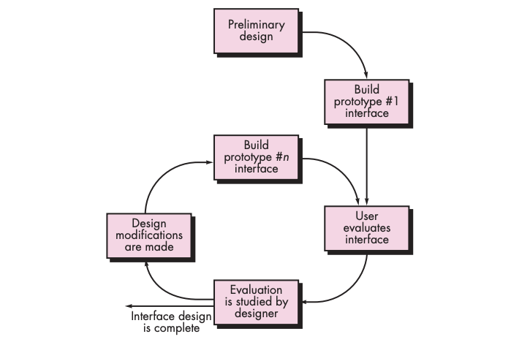
Design Workflow

Slide 27
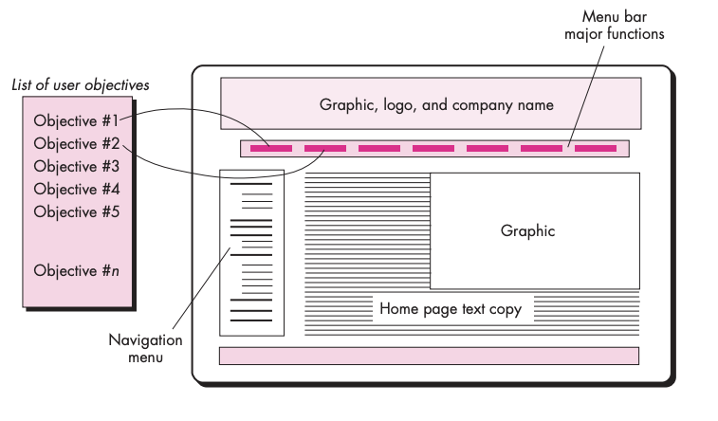
Mapping Objectives to Interface Actions

Slide 28
Interface Design Steps
Review use cases/requirements
Develop rough sketch of interface layout
Map user objectives into specific interface actions
Define a set of user steps associated with each action
Storyboard screen images for each action
Ask someone with aesthetic acumen to refine layout and storyboards
Identify UI objects needed to implement the interface
Develop the behavioral representation of the interface (state transitions)
Describe the interface layout for each state (use information from steps 2, 5)
Review and refine your design based on feedback (back to step 1)

Slide 29
Interactions Diagrams
During our discussions on GRASP patterns, we explained the concepts using ”Interaction Diagrams”.
These are your 4th type of UML diagrams you need to be familiar with in this course.

Slide 30
Interaction Diagrams
Two kinds, sequence diagrams and collaboration diagrams. They convey the same information with slightly different emphasis.
Sequence diagrams: Emphasize time and ordering of messages. It will be the primary visual cue. Structure is still there since you know who communicates with whom.
Collaboration diagrams: Emphasize structural relationships (who send messages to whom). Ordering and timing can be learned from numbering on messages.

Slide 31
From Use Cases
Pick the use case
Choose the scenario and system operation
Possibly check the operation contract for the operation
Identify participating entities
Apply Grasp principles to assign responsibilities to the right entities
Draw lifelines of the objects
Add messages between objects
Iterate if you find an object doing too much
Notes:
Operation contractions use a pre and post condition form to describe detailed changes to objects in a domain model
To create a contract – identify the system operations from the system sequence diagram

Slide 32

Use Case : Process Sale
Cashier selects MakeNewSale to begin a new sale.
System initializes a new, empty sale.
Cashier repeatedly invokes EnterItem for each product being purchased:
System looks up the product specification (price, description, etc.).
System creates a line item for the product in the current sale.
When there are no more items, Cashier invokes EndSale:
System calculates the total price and displays it.
Cashier invokes MakePayment:
System processes the payment (e.g., cash or electronic).
System records the payment and completes the sale.
System prints or displays a receipt for the Cashier and Customer.

Slide 33
Domain Model is by RE based on all Use Cases
Records-sale-of
Described-by
1
Product
Product
Catalog
Contains
Specification
1
1..
*
description
price
1
UPC
Association
0..1
*
Used-by
Describes
Sales
*
*
LineItem
Store
Stocks
Item
quantity
1
address
1
*
1
1..
*
name
Concepts
Contained-in
Logs-
1
Houses
1
completed
1..
*
6
Sale
*
register
date
Started-by
Manager
Captured-on
1
1
time
1
Paid-by
1
1
Initiated-by
1
3
Records-sales-on
Attributes
1
1
1
Payment
Customer
Cashier
amount

Slide 34
SSD Example for use case : Process Sale
SSD’s are an almost direct translation of the UC scenario(s).
Each use case can be visually represented with one system sequence diagram.
The system sequence diagram shall focus on visually presenting the main success scenario of the use case.
Notes:
Example of a sequence diagram
what are the differences between a SSD and a sequence diagram?
An SSD is just a sequence diagram with one primary actor and an object called ":System". That is the only difference.
If the object is called ":System" and it is the only object.... then the diagram is a SSD. Else it is not.
Semantics: SSDs show the sequence of events between an actor and the whole system. A sequence diagram should show the objects in side the system do something.
Object lifeline
Sometimes objects are placed lower to show their creation height.

Slide 35
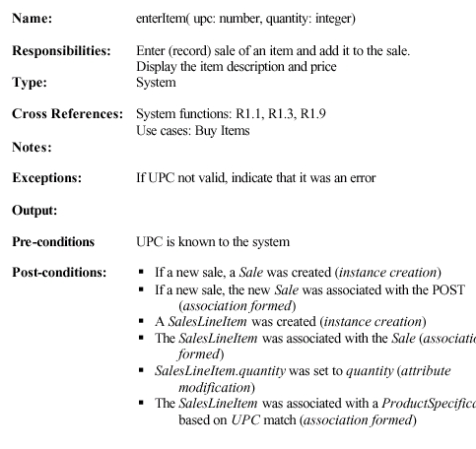
Operation Contract Example : for enterItem()
Operation Contracts are written for important system operations.
Each Operation Contract can be translated visually into one interaction diagram.
For example, in the next slide, we will show the interaction diagram that represents the operation enterItem()

Slide 36
Collaboration Diagram for enterItem(upc, qty)

Slide 37
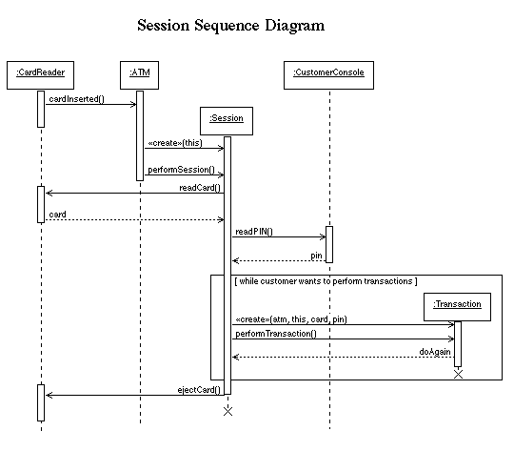
General Rules for drawing sequence diagrams
Place objects across your drawing field
Time flows downwards
Avoid too many arrows crossing multiple lifelines
Shift lifeflines of objects if necessary

Slide 38
More on Interaction Diagrams
Designer designs these operation contracts and interaction diagrams taking as an input:
All artifacts given by requirements engineer; specially the domain model
The importance to satisfy the GRASP Patterns where applicable
Can you try to find which GRASP Patterns were considered while designing enterItem()?

Slide 39

Object Communication
How do objects communicate with each other?
Interaction diagrams describe behavior, but the nature of the communication is implicit.
For an object to send a message to another, the receiver must be visible – the sender must have some kind of reference to the receiver.
Visibility is the ability of one object to see another.
Notes:
Reference (or pointer)
•Communication Diagrams show relationship between objects
•Sequence Diagrams focus on the time in which events occur
Visibility – see or have a reference to another object.

Slide 40
Attribute Visibility
B is visible to A if B is an attribute of A
Notes:
Take note of the Java class definition for POST, a POST instance may have attribute visibility to ProductCatalog, since it is an attribute of the POST class. This visibility is needed because in the enterItem method shown a POST instance needs to send the specification message to a ProductCatalog

Slide 41

In Class Exercise
Library Borrowing System

Slide 42


Readings , Assignments, Project Tasks
Read:
Chapters 9, 11, 12, 14 of the textbook.
Assignments & Project Tasks:
Assignment 2 is due next Friday. This is an individual Assignment.

Slide 43

Questions?

Slide 44
Readings , Assignments, Project Tasks
Read:
Chapters 8, 9, 10, 11, 12, 13 of the textbook.
Assignments & Project Tasks:
Project Deliverable 2 is due tomorrow. This is a group submission Assignment.
Assignment 2 will be released tomorrow. This is an individual submission.

Slide 45
Questions?

